Slide 1
Time-Resolved Thermoreflectance Imaging for Thermal Testing and Analysis
Dr. Mo Shakouri
Chairman
Microsanj, LLC., Silicon Valley USA
info@microsanj.com

Slide 2
Applications

Slide 3
Outline
Motivation
Instrumentation
Lock-in mechanism
Imaging through silicon (near IR)
Diffusion length
Examples
  Small hotspot / Logic circuitry / Emission /
  Depth in metal layers
Summary

Slide 4
Challenges on thermal characterization
General challenges for electronics devices
Small features: 10s nm – 100s microns – difficult to contact
High speed response due to the small thermal mass
Highly non-uniform
Additional challenges for photonics and power devices
Light emission (photonics)
High heat density
Heat sinks requirement (power devices)

Slide 5
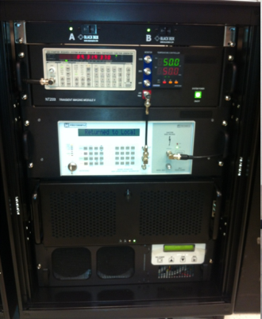
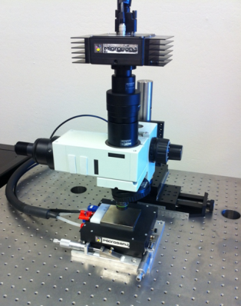
Thermoreflectance imaging setup
Console box
Microscope setup
CCD
Sig. gen.
Temp. contl.
LED
Control box.
Objective lens
DUT

Slide 6
How it works - thermoreflectance
LED driver
GP-IB
Power LED
PC
Light
Detector
CCD, InGaAs
Microscope
Objective
Pulse generator & power amp
Device
Thermal bed
System diagram
Thermoreflectance coefficient

Slide 7
Lock-in signals
Timing chart
4ms @ 25% Duty Cycle
t₀
Device Excitation
1ms
CCD exposure
33ms @ 30Hz
delay
t₀
100μs
t₁
t₁
LED pulse
Temperature
Acquisition timing (shifting by cycle)
Temperature data point along the bias cycle

Slide 8
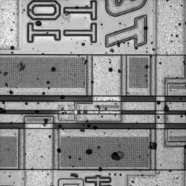
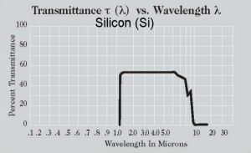
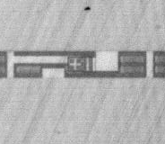
Through silicon and emission
Top view
InGaAs CCD
1300 nm
LED
Objective
Substrate
Flip Chip DUT
Transmittance vs Wavelength, Si
Bottom view
(Image from http://www.janis.com)
resolution
% Transmittance
1.0
10.0
Wavelength, μm

Slide 9
Defects and signature of potential failure
Emission – sign of high density of electron collisions
Thermal hotspot – location of potential long-term reliability
Thermal foot print → irregular local energy spot
Arrhenius's law
Transient irregular timing - potential of logic/operation failure
Near Infrared (NIR) wavelength provide a capability of both thermal signal and emission simultaneously.
LED options: 1050, 1200, 1300, and 1500 nm

Slide 10
Resolution and sensitivity
Temperature
n : number of averaging
due to the weak signal (C_{th} ~ 10⁻⁴ order)
Spatial resolution
Visible wavelengths, d ≈ 250-300 nm
NIR d ≈ 500 nm
d ≈ λ/2
Time resolution
As scaling smaller, time resolution must be smaller due to thermal diffusion.
Δt : 100ns for our setup.
(for 1% error in temperature)
Emission
InGaAs uncooled camera effective sensitivity of one pixel for emission ~ 30 mW/mm²

Slide 11
Examples - Small hotspot
a)
1.4 μm gate on MOSFET
1.4 μm gate on MOSFET
60
50
40
40
Temperature (a.u.)
30
b)
20
10
0
0
2
4
6
8
10
12
Distance (μm)

Slide 12





Transient Behavior of IC Latch-Up
Movie1
- Potential timing failure -
0.5 ms
0.7 ms
0.9 ms
1.0 ms
3.0 ms
The latch-up location is circled in yellow

Slide 13
Thermal and emission overlay images
5x
Thermal signals
Through silicon substrate, 450 μm thick.
LED λ = 1300nm and
InGaAs camera (640 x 512)
50x
Emission signals
44 μW

Slide 14
Diffusion time/depth estimations
μ: depth of heat source
α: thermal diffusivity [m²/s]
t: time to reach observing surface

Slide 15
Examples - Through silicon, deep under the 6th metal layer
Movie2
2.0 msec
0.97V, ~12mA, ~12mW 20% duty cycle
10 minutes of averaging (repeating)

Slide 16
Time delay to reach to the surface
Precise time resolution is a key to find the response.

Slide 17
Microsanj, a technology leader in thermal imaging field
Founded by a team of PhDs from CalTech, Stanford, and UCSC in 2007
More than 30 papers published to date
Major Customers
  Chip Test Solutions
  Design Engineering Inc. (DEI)
  Infinera
  Instituto de Microelectronica de Barcelona (CSIC)
  Intel Corporation
  Nanyang Technological University
  Purdue University
  Raytheon
  Silicon Image
  University of California Santa Barbara
Collaborative Research Activities
  A*Star Singapore
  Altera Corporation
  Birck Nanotechnology Center at Purdue University
  Nvidia
  Philips Electronics
  Qualcomm
  Silicon Frontline
  Si-Ware Systems
  ST Microelectronics
  Texas Instruments (National Semiconductor)
  University of California at Santa Cruz

Slide 18
Summary
High speed time-resolved thermoreflectance imaging is introduced.
NIR illumination provides a through Si and electron emission
Lock-in thermography and EMMI are compared.
Examples demonstrated:
Hotspots ~ 1μm, emission and thermal overlay,
and a hotspot underneath 6 metal layers

Slide 19
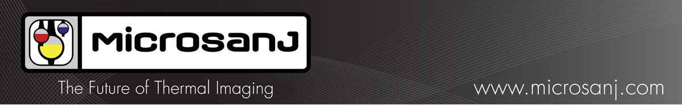
Microsanj社の 開発した熱画像解析装置、Nanothermシリーズは、これまでのIRによるサーモグラフィー装置とは 全く異なった温度測定技術を用いたシステムです。測定物のIR放射を測定するのではなく、 測定物に非常に短時間の光を照射し、その反射光を計測することにより温度分布を測定するため、 測定物に全く影響を与えること無く、IRでは難しかった広い温度範囲を非接触にて測定することが 可能となりました。測定は金属を含むあらゆるものが可能で、測定物を熱したり、表面に特別な処理を 行う必要が有りません。また、薄いシリコン基板は光を透過することから、flip-chip等の、シリコン基板上の 半導体の熱画像を裏面から観測することが可能です。また、Nanothermシステムの最大の特徴として、 オプションにてバイアス電源と信号源を追加することにより、熱画像の過渡特性を、最速では0.8nsec間隔で 測定することができます。Nanothermシステムにより、温度上昇、熱集中の状況をリアルタイムに観察することで、 半導体そのものや半導体回路の最適な熱設計を行うこと、また故障解析、不良解析を行うことが可能です。 測定物の大きさは最小300nm、温度分解能は最小0.2℃、測定温度範囲-265～500℃に対応します。
ATN Japan
1-35-16 Nakagawa-Chuo
Tsuzuki, Yokohama, Kanagawa, 224-0003 JAPAN
Website: www.atnjapan.com
E-mail: sales@atnjapan.com

Slide 20
Transient thermal/emission imaging
Method | Resolution |  |  | Imag-ing? | Notes
 | x(μm) | T (K) | t (sec)
μ Thermocouple | 50 | 0.01 | 0.1-10 | No | Contact method
IR Thermography | 3-10 | 0.02-1 | 1μ | Yes | Emissivity dependent
Lock-in Thermog. | 3-10 | 1μ | NA | Yes | Need cycling
Liquid Crystal Thermography | 2-5 | 0.5 | 100 | Yes | Only near phase transition (aging issues)
Thermo-reflectance | 0.3- 0.5 | 0.08 | 800p- 0.1μ | Yes | Need cycling
Optical scanning Interferometry | 0.5 | 100μ | 6n- 0.1μ | Scan | Indirect measurement (expansion)
Micro Raman | 0.5 | 1 | 10n | Scan | 3D T-distribution
Scanning thermal microscopy (SThM) | 0.05 | 0.1 | 10-100μ | Scan | Contact method surface morphology
Emission Microscopy (EMMI) | 0.25 s.im.lens | - | Op lock-in | Yes | Emitted Photon density

